Slide 1

Semantic Web: An Introduction

Slide 2
Presentation Outline
Today’s Web.
The Semantic Web Impact.
Semantic Web Technologies.

Slide 3
Today’s Web
Most of today’s Web content is suitable for human consumption.
Typical Web uses of today’s people’s
  seeking and making use of information,reviewing catalogs of online stores and ordering products.
Main Tools For Using Today’s Web
Yahoo and Google (Key word based search engine)

Slide 4
Problems of Keyword-Based
Search Engines and Today’s Web
High recall, low precision.
Results are highly sensitive to vocabulary
Human involvement is necessary to interpret and combine results
Problem of Today’s Web
The meaning of Web content is not machine-accessible: lack of semantics

Slide 5
The Semantic Web Approach
Represent Web content in a form that is more easily machine-processable.
Use intelligent techniques to take advantage of these representations.
The Semantic Web will gradually evolve out of the existing Web, it is not a competition to the current WWW

Slide 6
The Semantic Web Impact – Knowledge Management
Knowledge management concerns itself with acquiring, accessing, and maintaining knowledge within an organization
Most information is currently available in a weakly structured form.

Slide 7
Limitations of Current Knowledge Management Technologies
Searching information
  Keyword-based search engines
Extracting information
  human involvement necessary for browsing, retrieving, interpreting, combining
Viewing information
  Impossible to define views on Web knowledge

Slide 8
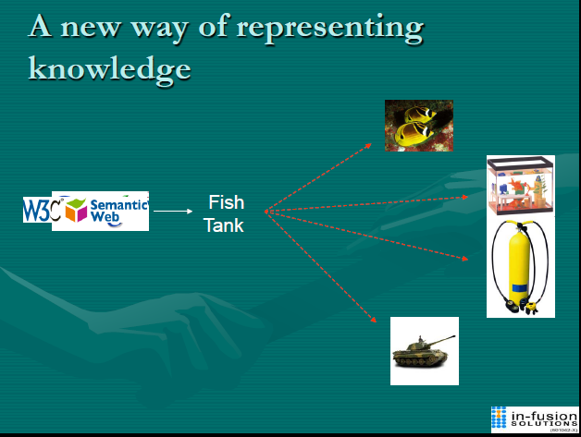
Semantic Web Enabled Knowledge Management
Knowledge will be organized in conceptual spaces according to its meaning.
Automated tools for maintenance and knowledge discovery
Defining who may view certain parts of information (even parts of documents) will be possible.

Slide 9
Components of
Semantic Web Technologies
Explicit Metadata
Ontologies
Logic and Inference
Agent

Slide 10
A Portion of a Typical Web Page of a Physical Therapist (On HTML)
<h1>Agilitas Physiotherapy Centre</h1>
Welcome to the home page of the Agilitas Physiotherapy Centre. Do
you feel pain? Have you had an injury? Let our staff Lisa Davenport,
Kelly Townsend (our secretary) and Steve Matthews take care of you.
<h2>Consultation hours</h2>
Mon 11am - 7pm<br>
Tue 11am - 7pm<br>
Wed 3pm - 7pm<br>
Thu 11am - 7pm<br>
Fri 11am - 3pm<p>

Slide 11
Problems with HTML
Humans have no problem with this
Machines (software agents) do
  How distinguish therapists from the secretary,
  How determine exact consultation hours

Slide 12
A Better Representation
<company>
<treatmentOffered>Physiotherapy</treatmentOffered>
<companyName>Agilitas Physiotherapy Centre</companyName>
<staff>
<therapist>Lisa Davenport</therapist>
<therapist>Steve Matthews</therapist>
<secretary>Kelly Townsend</secretary>
</staff>
</company>
Why Better?
This representation is far more easily processable by machines
Metadata: data about data
Metadata capture part of the meaning of data thus the term Semantic in “Semantic Web”

Slide 13
Ontologies
Definition of Ontology-
An ontology is an explicit and formal specification of a conceptualization
Typical Components of Ontology-
Terms denote important concepts (classes of objects) of the domain
  e.g. professors, staff, students, courses, departments
Relationships between these terms: typically class hierarchies
  e.g. all professors are staff members

Slide 14
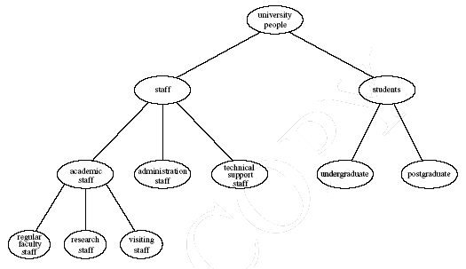
Example of a Class Hierarchy

Slide 15
The Role of Ontologies on the Web Search
Ontologies are useful for improving the accuracy of Web searches
Web searches can exploit generalization/ specialization information

Slide 16
Web Ontology Languages
RDF Schema
RDF is a data model for objects and relations between them
RDF Schema is a vocabulary description language
Describes properties and classes of RDF resources
Provides semantics for generalization hierarchies of properties and classes
OWL
A richer ontology language
relations between classes (e.g., disjointness)
cardinality (e.g. “exactly one”)
richer typing of properties
characteristics of properties (e.g., symmetry)

Slide 17
Logic and Inference
Logic is the discipline that studies the principles of reasoning
Formal languages for expressing knowledge
An Inference Example:
prof(X) → faculty(X)
faculty(X) → staff(X)
prof(michael)
We can deduce the following conclusions:
faculty(michael)
staff(michael)
prof(X) → staff(X)

Slide 18
Agents
Pieces of software work autonomously and proactively
Semantic Web Agent Technologies
Metadata
  Identify and extract information.
Ontologies
  Web searches, interpret retrieved information
Logic
  Process retrieved information, draw conclusions

Slide 19
Conclusion
The semantic web is an initiative that aims to improve the current state of World Wide Web.
The key idea is the use of machine-processable web information
Key technologies include explicit metadata, ontology, logic and inferencing, Agent.

Slide 20
References
1. A semantic web primer by Grigoris Antoniou and Frank van Harmelen
2.http://eprints.ecs.soton.ac.uk/12614/1/Semantic_Web_Revisted.pdf
3.http://www.cs.vu.nl/~frankh/postscript/IEEE-IC00.pdf

Slide 21
Thank you

